Slide 1


SQL PROJECT
FINANCE AND SUPPLY CHAIN ANALYTICS AT ATLIQ HARDWARE
PRESENTED BY ABDUL NAAFAY

Slide 2
Table Of Contents
About AtliQ HARDWARE
Business Model
Problem Statement
Project Overview
Reports
Conclusion

Slide 3
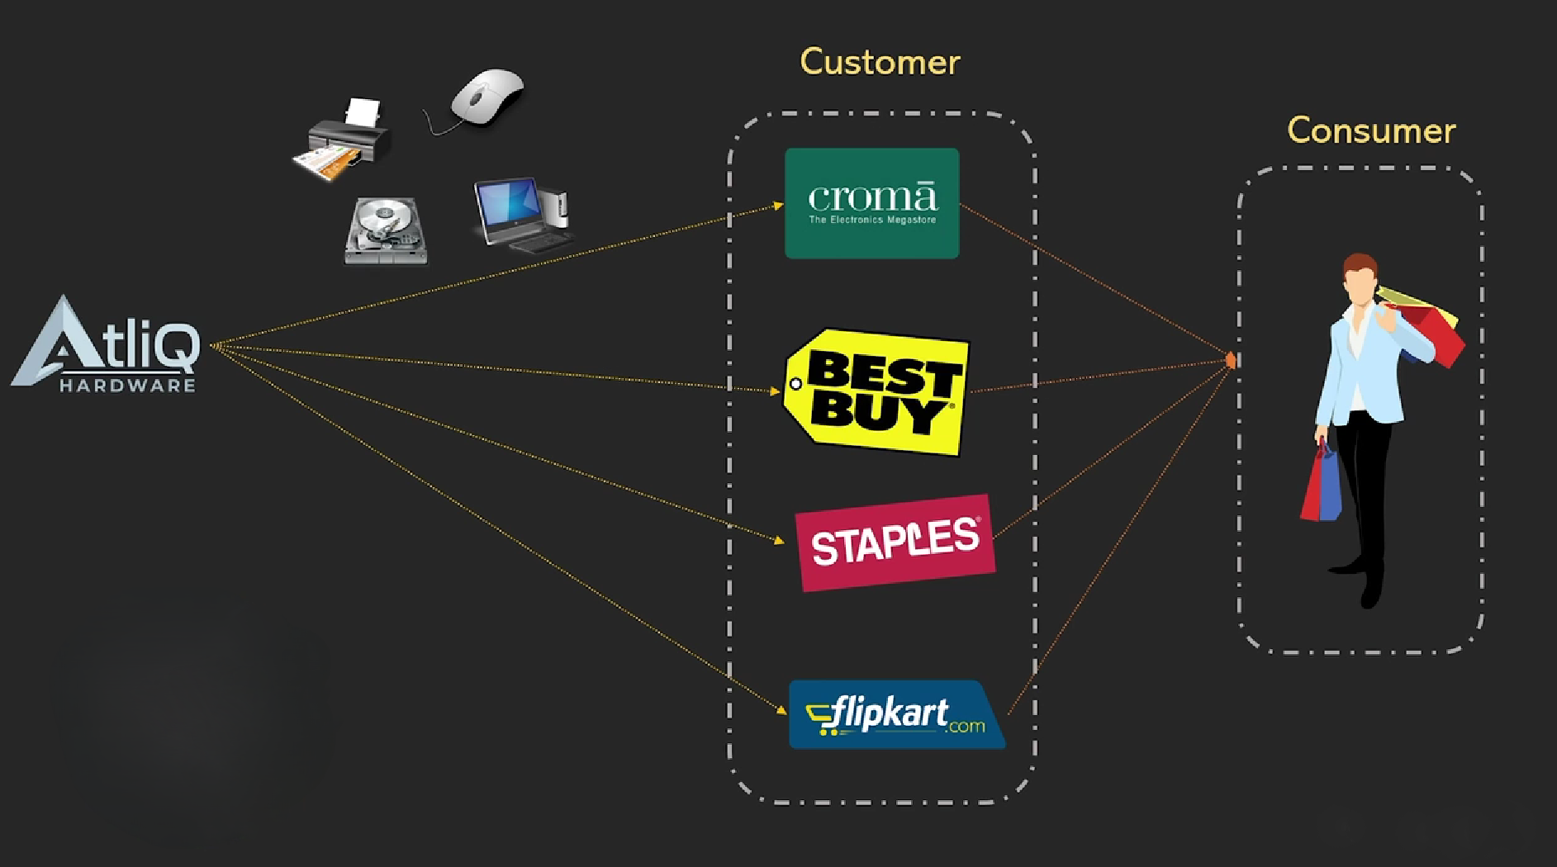
About AtliQ Hardware and its Business Model
AtliQ hardware is a distinguished global leader in electronics manufacturing, specializing in the production and distribution of an extensive range of high-quality hardware products. Our offerings include personal computers, printers, mouse, and a variety of other computer peripherals, serving the diverse needs of customers worldwide.

Slide 4
Problem Statement And Project Overview
Atliq Hardware is currently facing performance challenges due to the increasing size and complexity of its excel files. To address this, the company has formed a dedication team of data analysts to leverage MYSQL for extracting valuable insights and enhancing operational efficiency.
Problem Statement
The scope of this project entails conducting an in - depth analysis of the dataset provided by atliq hardware. The primary goal is to derive actionable insights regarding sales performance, market dynamics, customer behaviour, and to forecast supply chain trends.
Project Overview

Slide 5
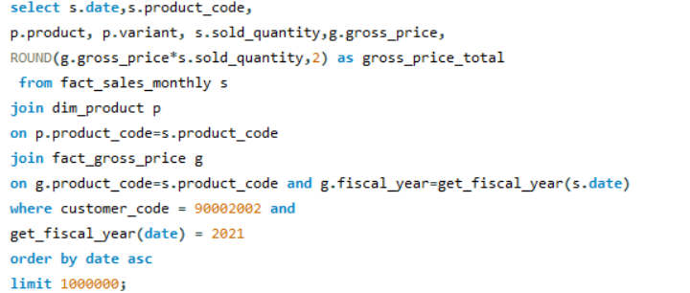
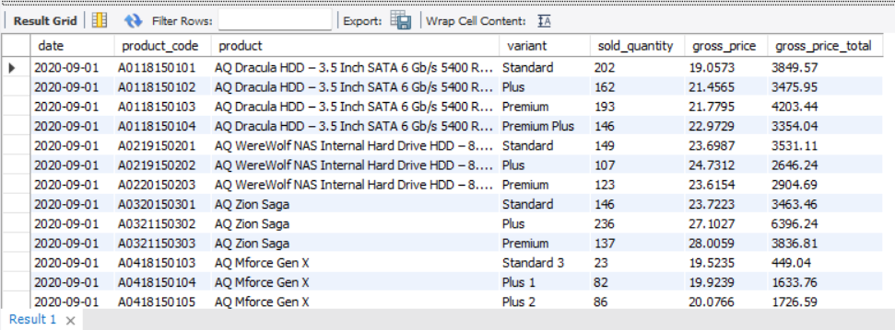
Generate a report detailing the individual product sales for Croma India customer throughout the fiscal year 2021

Slide 6
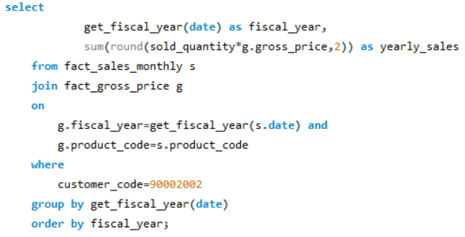
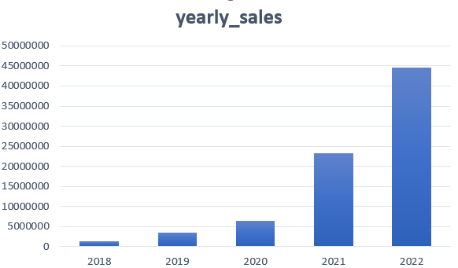
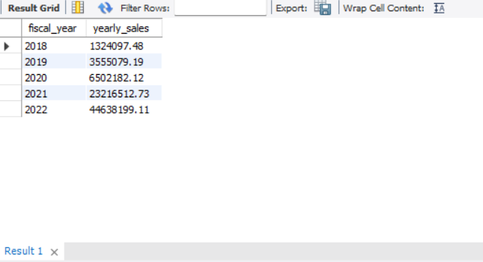
Generate a yearly report for Croma India where there are two columns 1. Fiscal Year 2. Total Gross Sales amount in that year for Croma

Slide 7
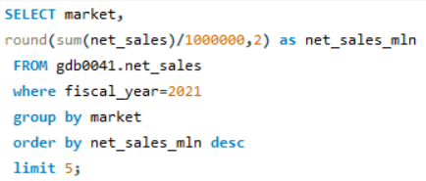
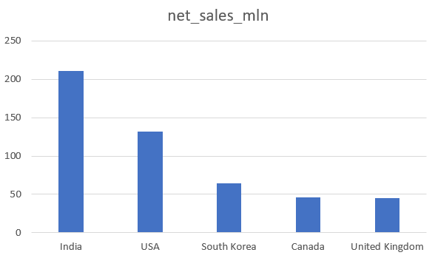
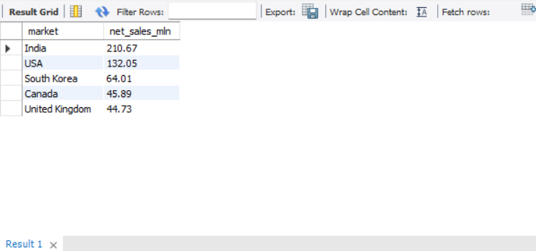
Generate a report getting top 5 markets by net sales in fiscal year 2021

Slide 8
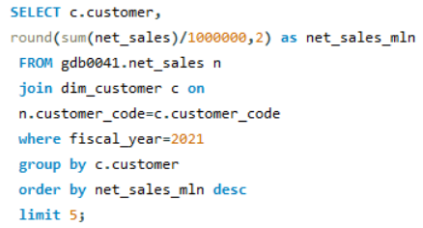
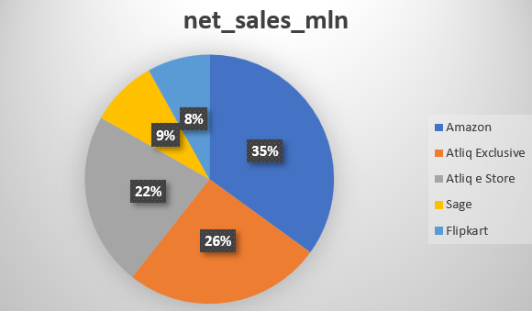
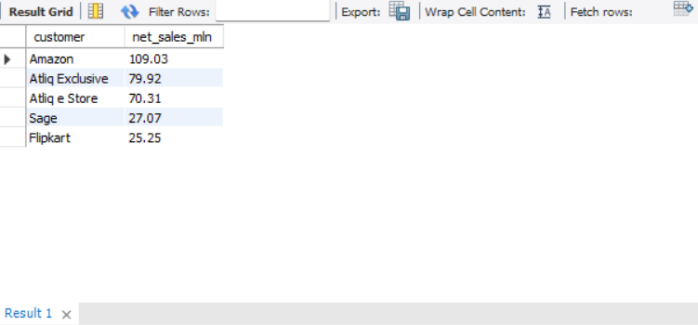
Generate a report getting top 5 customers by net sales in fiscal year 2021

Slide 9
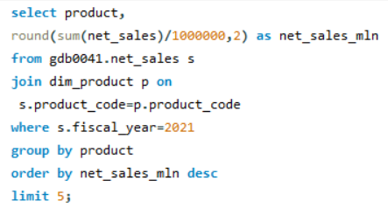
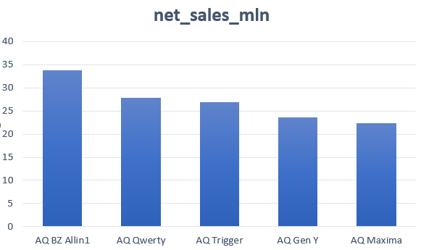
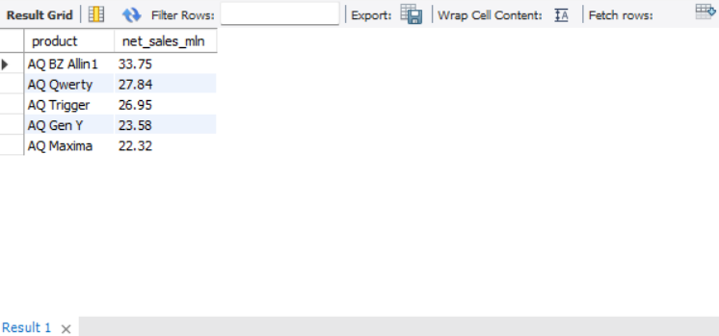
Generate a report getting top 5 products by net sales in fiscal year 2021

Slide 10
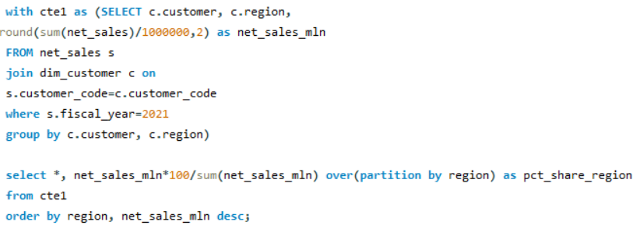
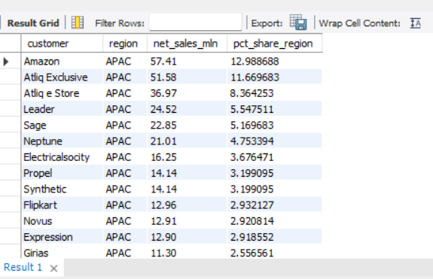
Generate a net sales % report of customers in different region

Slide 11
Conclusion
AtliQ Hardware achieved record sales in 2022
India was the largest market in 2021 with sales of $210.67M.
Amazon generated the highest net sales in 2021 with $109.03M.
The AQ BZ All-in-one was the top-selling product in 2021 with sales of $33.75M.

Slide 12
Thank You and have a nice day

